Slide 1

Streams
C H A P T E R 4
We will not be satisfied until justice rolls down like waters and righteousness like a mighty stream.
—The Reverend Martin Luther King, Jr., I Have a Dream, August 28, 1963 (paraphrasing Amos 5:24)
4.1 Formatted output
4.2 Formatted input
4.3 Data files
4.4 Reading files
4.5 String Streams
4.6 Class hierarchies

Slide 2
Introduction to the C++ Libraries
A collection of classes and functions, which are written in the core language and part of the C++ ISO Standard (98/11) itself. Features of the C++ Standard Library are declared within the std namespace
Containers: vector, list, queue, stack, map, set, etc.
General: algorithm, functional, iterator, memory, etc.
Strings
Streams and Input/Output: iostream, fstream, sstream, etc.
Localization
Language support
Thread support library
Numerics library
C standard library: cmath, cctype, cstring, cstdio, cstdlib, etc.

Slide 3
Formatted Output: insertion
Ever since the very first program in the text, which displayed the message "hello, world" on the screen, the programs in this text have made use of an important data structure called a stream, which C++ uses to manage the flow of information to or from some data source.
In the earlier chapters, you have used the << and >> operators and have already had occasion to use the three standard streams exported by the <iostream> library: cin, cout, and cerr.
Later, to implement file-processing applications, we will learn the notion of data files.
Finally, we explore the structure of the C++ stream classes as a representative example of inheritance hierarchies in an object-oriented language.

Slide 4
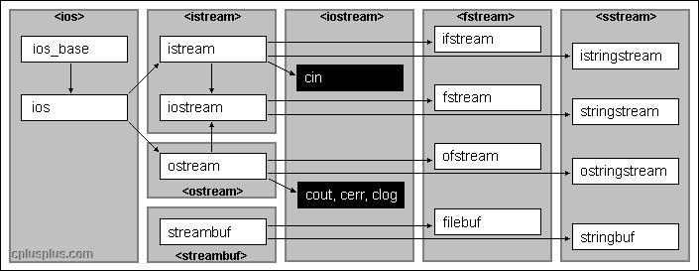
The Stream Libraries

Slide 5
The Insertion Operator
The standard technique to specify formatted output in C++ uses the insertion operator, which is written as <<. This operator takes an output stream on the left and an expression of any type on its right. The effect is to write the value of the expression to the output stream using the current format settings.
The insertion operator returns the output stream as its value. The advantage of this interpretation is that output operations can be chained together, as in the following statement:
C++ allows you to control the output by including items in the output chain called manipulators (<iomanip>), which affect the way how subsequent values are formatted. A list of the most common output manipulators appears on the next slide.
cout << "The total is " << total << endl;
insert(insert(insert(cout, "The total is "), total), endl);
Notes:
insert ( insert ( insert ( cout, "The total is " ), total ), endl );

Slide 6
Output Manipulators
endl
Moves cursor to the next line.
setw(n)
Sets the width of the next value to n characters.
setprecision(digits)
Sets how many digits should appear.
setfill(ch)
Sets the fill character used to pad values.
left
Aligns the value at the left edge of the field.
right
Aligns the value at the right edge of the field.
fixed
Sets fixed-point output (no scientific notation).
scientific
Sets scientific-notation output.
showpoint/noshowpoint
Controls whether a decimal point must appear.
showpos/noshowpos
Controls appearance of a plus sign.
uppercase/nouppercase
Controls whether uppercase is used in hex.
boolalpha/noboolalpha
Controls whether bools appear as true/false.
Notes:
PrecisionExercise.cpp

Slide 7
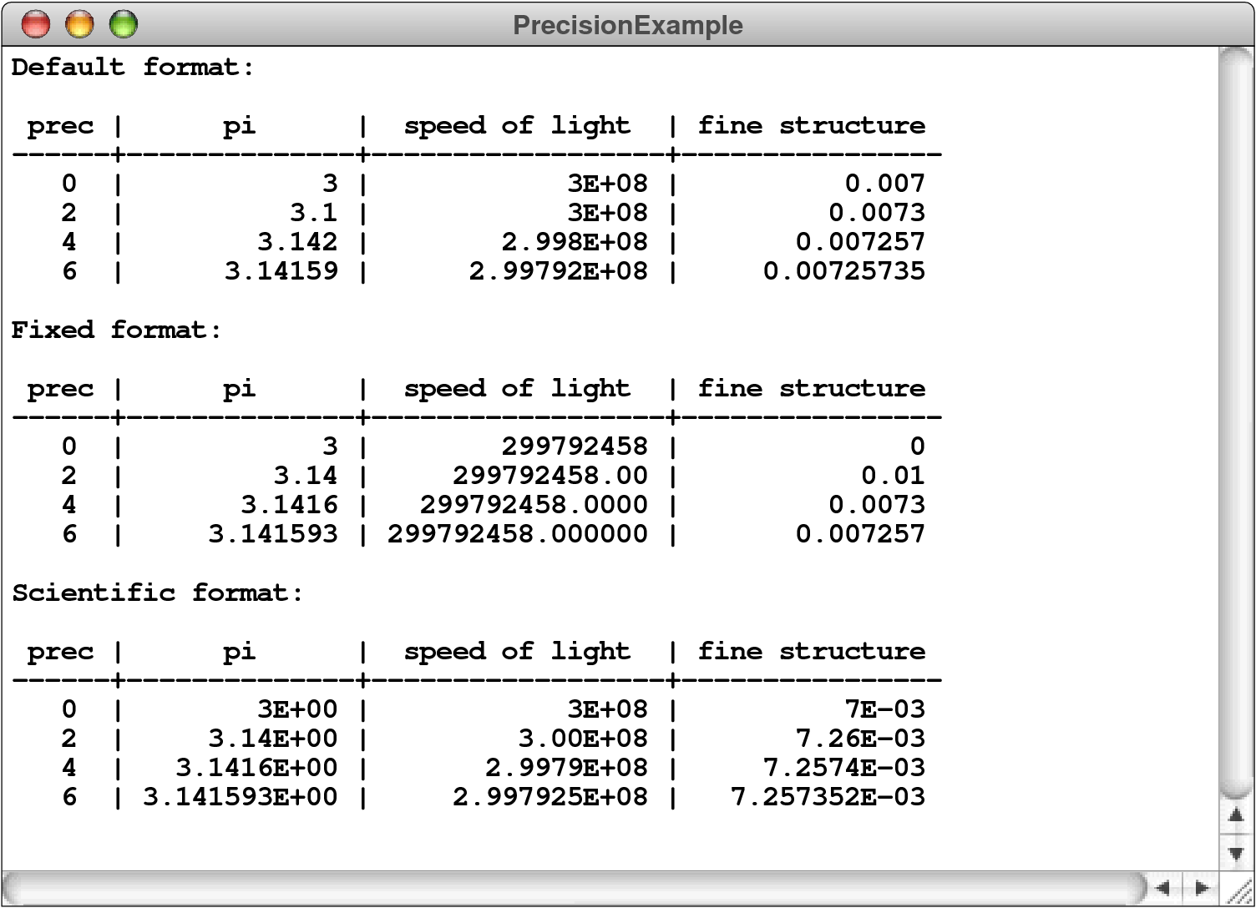
Precision Example
Notes:
Show PrecisionExample.cpp

Slide 8
Precision Example
int main() {
cout << uppercase << right;
cout << "Default format:" << endl << endl;
printPrecisionTable();
cout << endl << "Fixed format:" << fixed << endl << endl;
printPrecisionTable();
cout << endl << "Scientific format:" << scientific << endl << endl;
printPrecisionTable();
return 0;
}
void printPrecisionTable() {
cout << " prec | pi | speed of light | fine structure" << endl;
cout << "------+---------------+------------------+----------------" << endl;
for (int prec = 0; prec <= 6; prec += 2) {
cout << setw(4) << prec << " |";
cout << " " << setw(13) << setprecision(prec) << PI << " |";
cout << " " << setw(16) << setprecision(prec) << SPEED_OF_LIGHT << " |";
cout << " " << setw(14) << setprecision(prec) << FINE_STRUCTURE << endl;
}
}
Notes:
Show PrecisionExample.cpp

Slide 9
Formatted Input: extraction
For input, C++ includes the >> operator, which is called the extraction operator. The >> operator is symmetrical to the << operator and reads formatted data from the stream on the left into the variables that appear on the right.
Up to now, you have used the >> operator to request input values from the console (PowerOfTwo):
Similar to the << operator, you can use manipulators to affect the way how subsequent values are formatted:
int limit;
cout << "Enter exponent limit: ";
cin >> limit;
char ch;
cout << "Enter a single character: ";
cin >> noskipws >> ch;

Slide 10
Input Manipulators
Exercise:
char a, b, c;
cout << "Enter at least 3 character: ";
cin >> noskipws >> a >> ws >> b >> skipws >> c;
cout << a << b << c << endl;
Notes:
TestInputManip.cpp
Input: whitespace|A|whitespace|whitespace|B|whitespace|whitespace|whitespace|C
Output: whitespace|AB
Remove skipws
Output: whitespace|A|whitespace

Slide 11
Data Files
A file is the generic name for any named collection of data maintained on the various types of permanent storage media attached to a computer. In most cases, a file is stored on a hard disk, but it can also be stored on removable medium, such as a CD or flash memory drive.
Files can contain information of many different types. When you compile a C++ program, for example, the compiler stores its output in an object file containing the binary representation of the program. The most common type of file, however, is probably a text file, which contains character data of the sort you find in a string.

Slide 12
Text Files vs. Strings
Although text files and strings both contain character data, it is important to keep in mind the following important differences between text files and strings:
The information stored in a file is permanent. The value of a string variable persists only as long as the variable does. Local variables disappear when the method returns, and instance variables disappear when the object goes away, which typically does not occur until the program exits. Information stored in a file exists until the file is deleted.
Files are usually read sequentially. When you read data from a file, you usually start at the beginning and read the characters in order, either individually or in groups that are most commonly individual lines. Once you have read one set of characters, you then move on to the next set of characters until you reach the end of the file.

Slide 13
Using Text Files
When you want to read data from a text file as part of a C++ program, you need to take the following steps:
Construct a new ifstream (i.e., input file stream) object that is tied to the data in the file by declaring a stream variable to refer to the file.
Call the open method for the stream. This phase of the process is called opening the file. For historical reasons, the argument to open is a C string literal rather than a C++ string object.
Call the methods provided by the ifstream class to read data from the file in sequential order. The text of the file can be read in several ways, including character by character or line by line.
Break the association between the reader and the file by calling the stream’s close method, which is called closing the file. This is important because before you close the file, no one else can use the file.

Slide 14
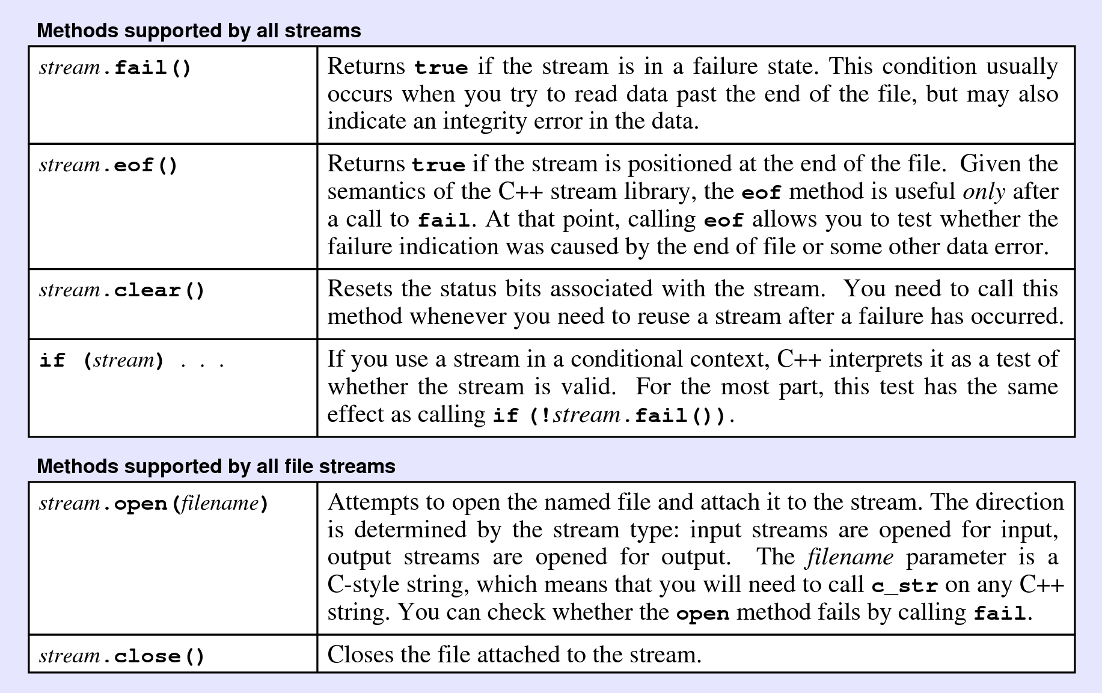
Using Text Files

Slide 15
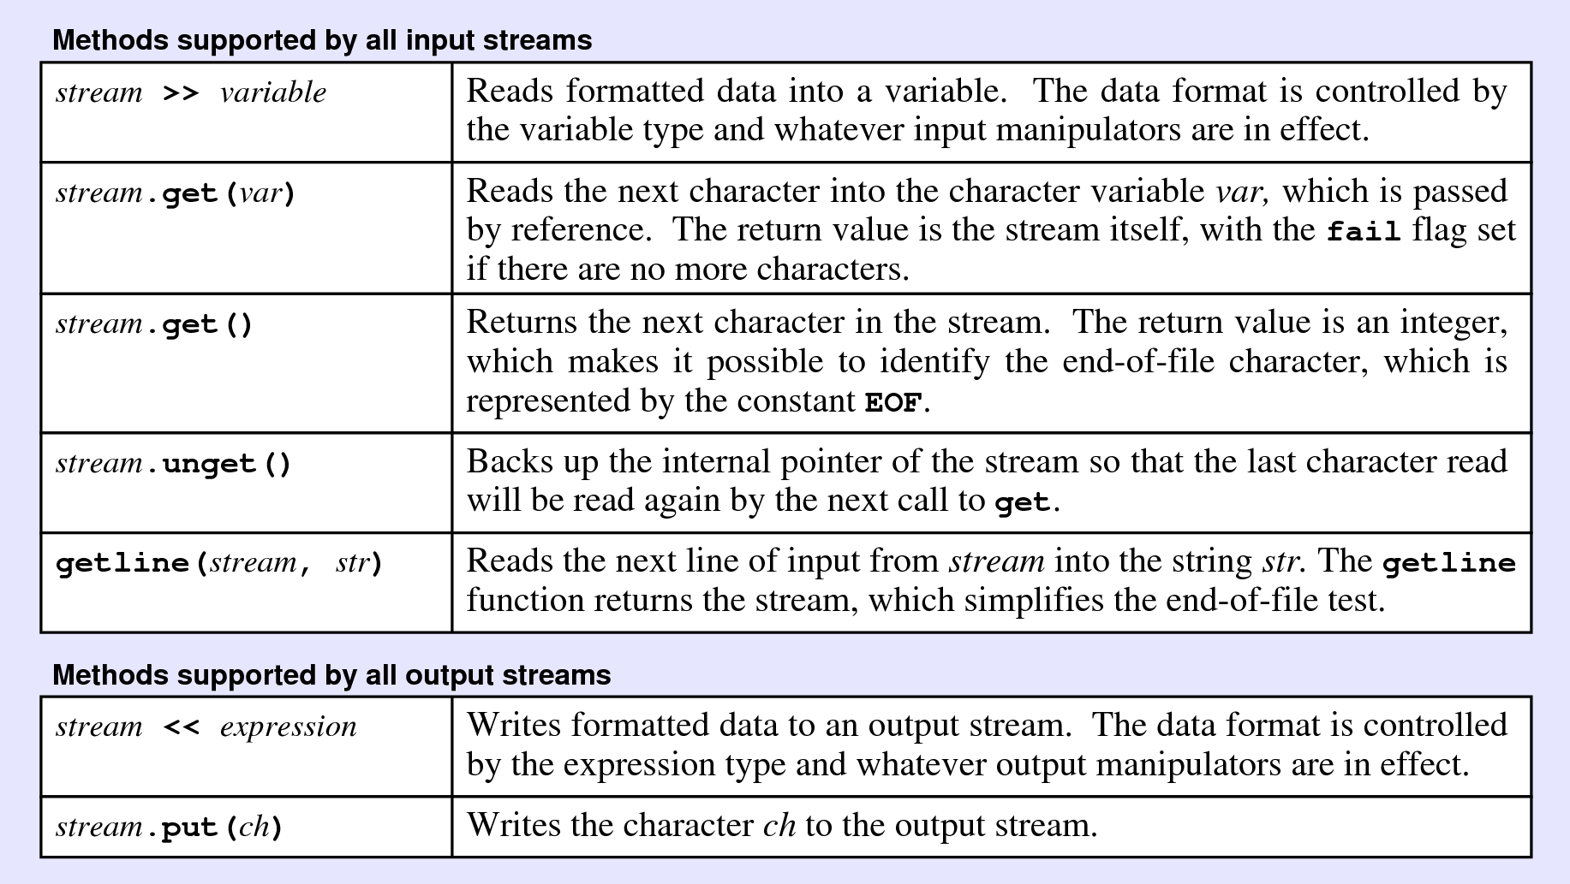
Using Text Files

Slide 16
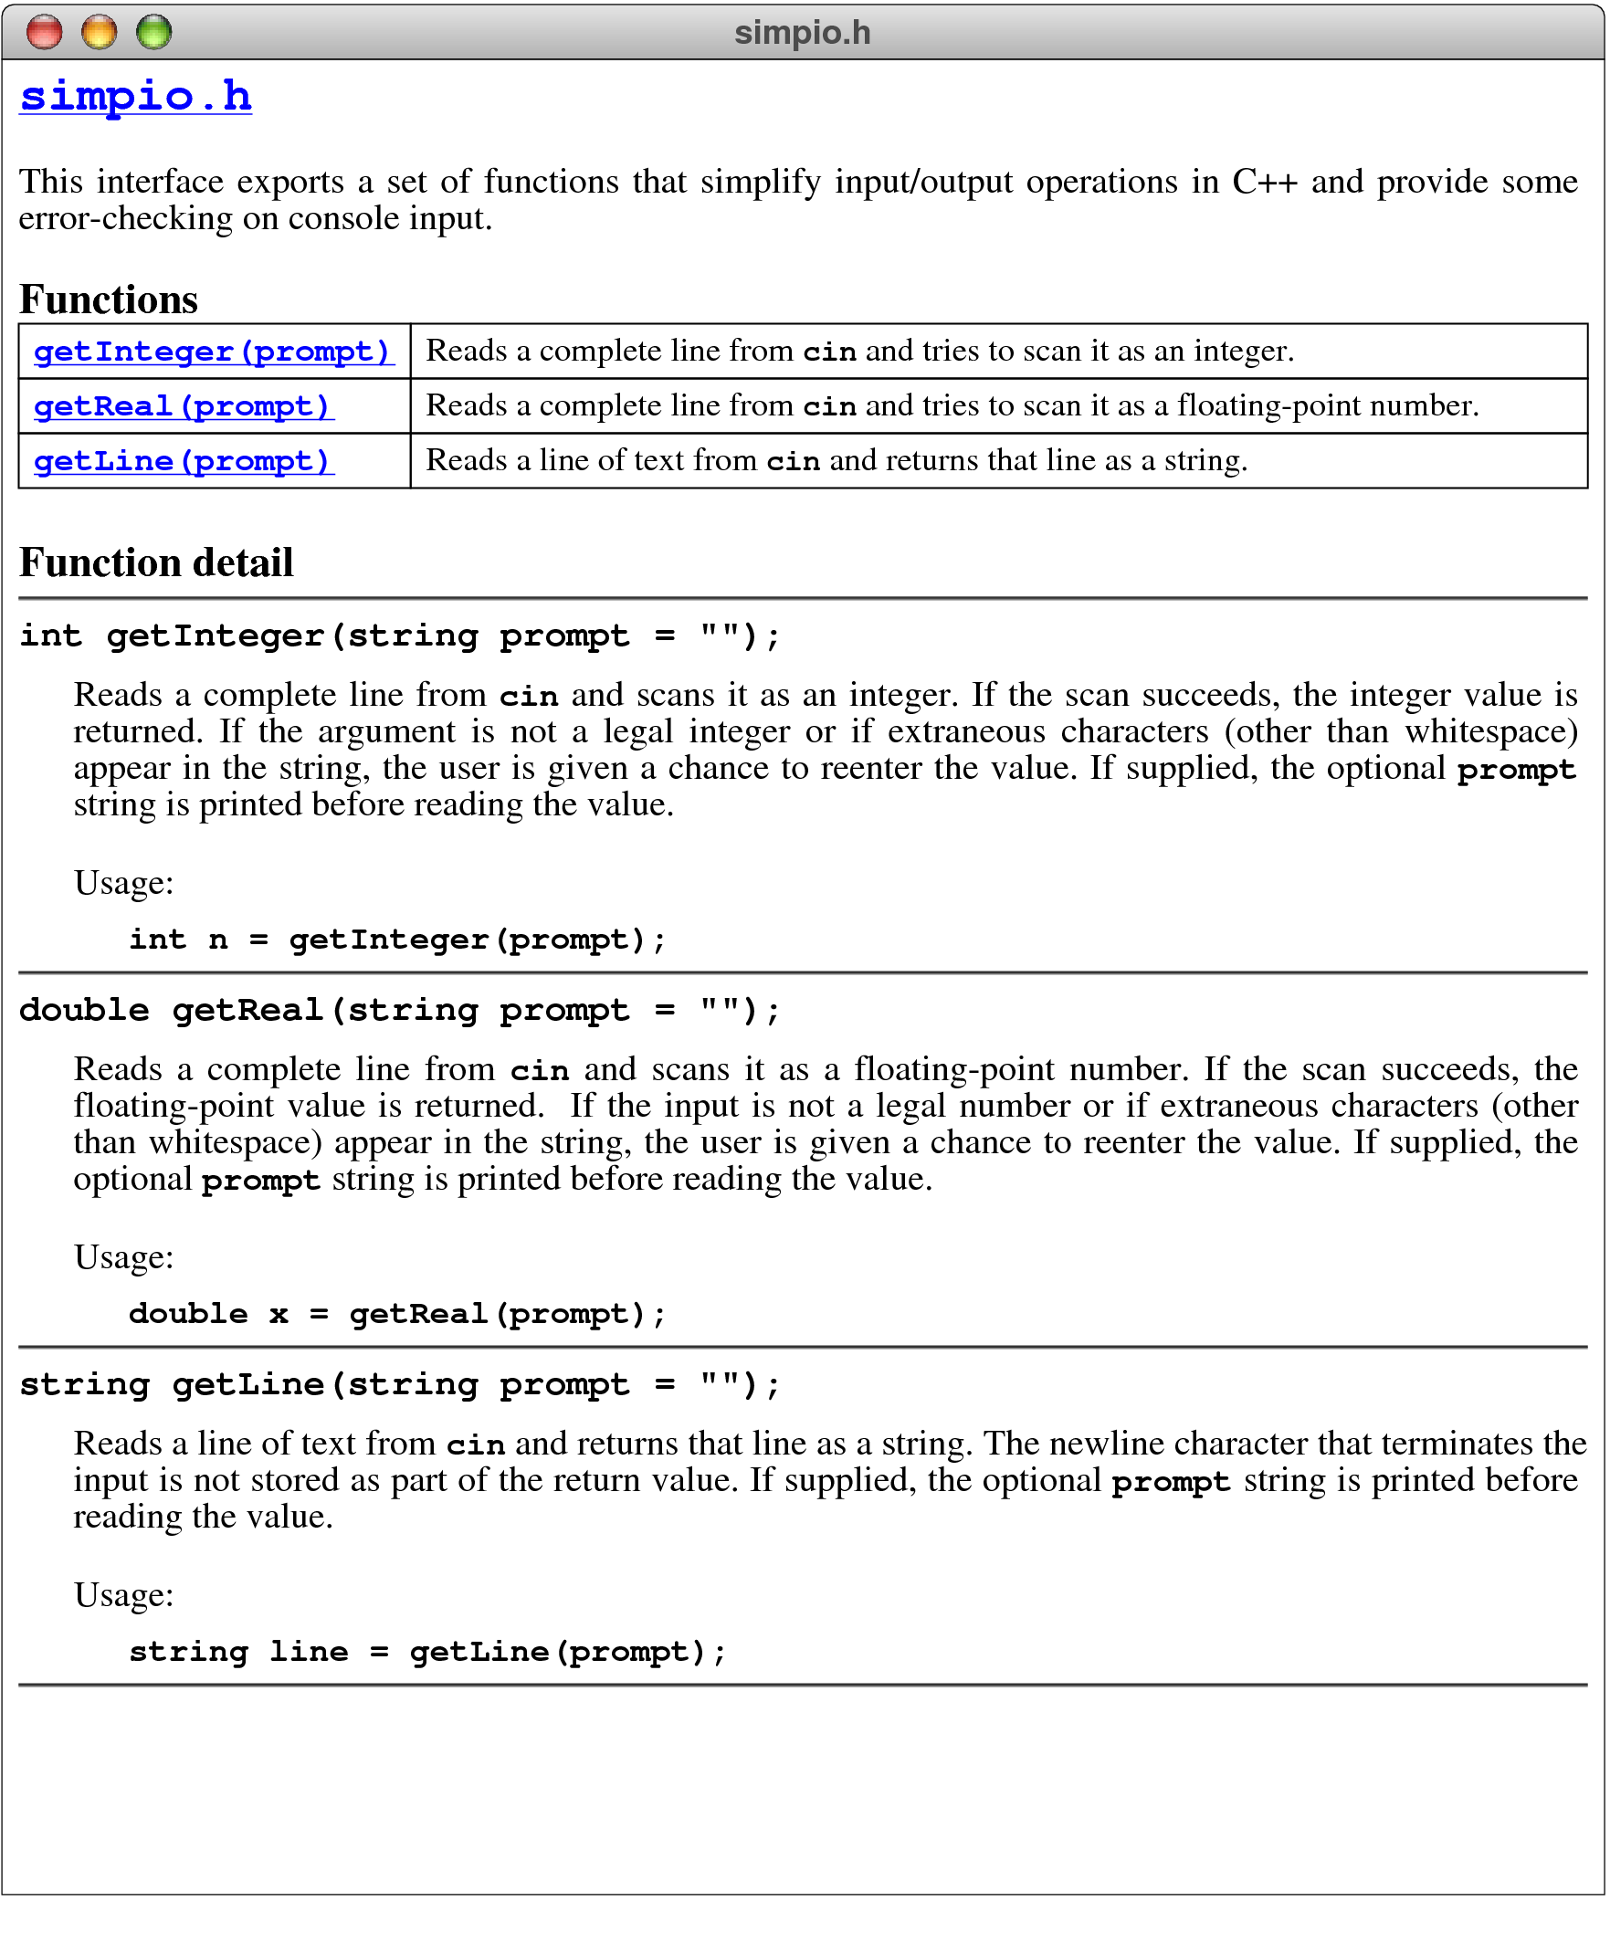
The simpio.h Interface
https://stanford.edu/~stepp/cppdoc/simpio.html

Slide 17
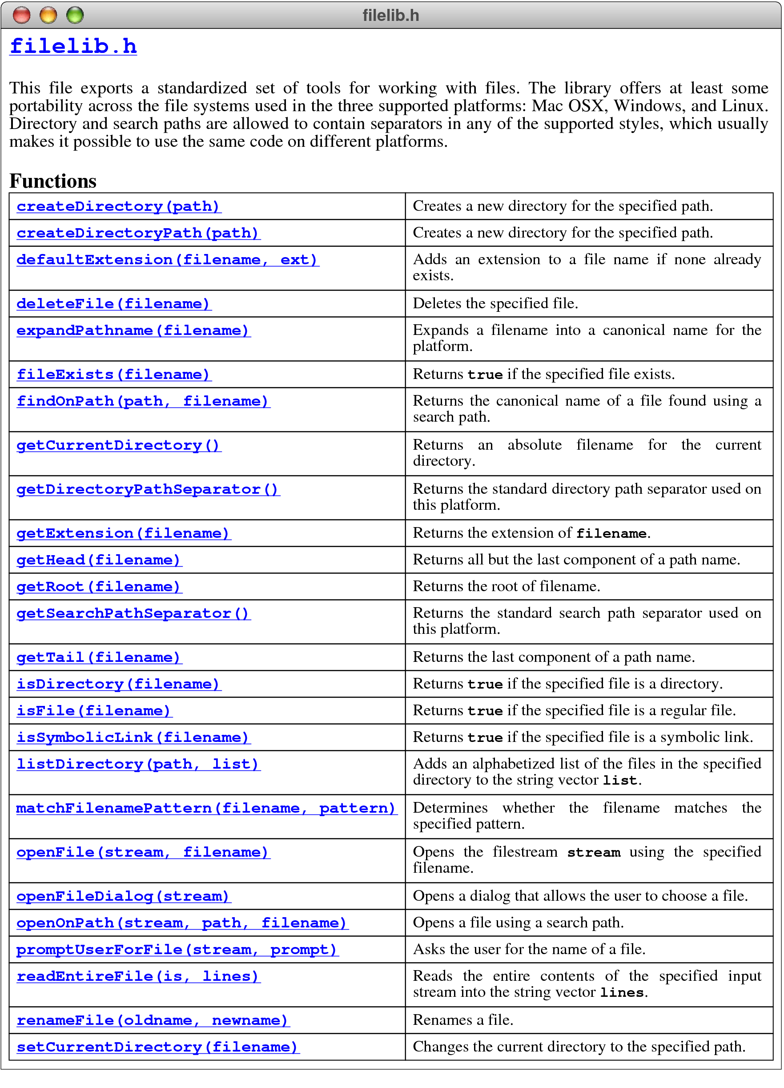
The filelib.h Interface
https://stanford.edu/~stepp/cppdoc/filelib.html

Slide 18

Web Documentation for filelib.h
The StanfordCPPLib package
filelib.h
Function Detail
bool openFile(ifstream & stream, string filename);
bool openFile(ofstream & stream, string filename);
Opens the filestream stream using the specified filename. This function is similar to the open method of the stream classes, but uses a C++ string object instead of the older
C-style string. If the operation succeeds, openFile returns true; if it fails, openFile sets the failure flag in the stream and returns false.
Usage:
if (openFile(stream, filename)) ...
string promptUserForFile(ifstream & stream, string prompt = "");
string promptUserForFile(ofstream & stream, string prompt = "");
Asks the user for the name of a file. The file is opened using the reference parameter stream, and the function returns the name of the file. If the requested file cannot be opened, the user is given additional chances to enter a valid file. The optional prompt argument provides an input prompt for the user.
Usage:
string filename = promptUserForFile(stream, prompt);

Slide 19
Opening an Input File
/*
* File: filelib.h
* ---------------
* This file exports a standardized set of tools for working with
* files . . .
*/
#ifndef _filelib_h
#define _filelib_h
/*
* Function: promptUserForFile
* Usage: string filename = promptUserForFile(stream, prompt);
* -----------------------------------------------------------
* Asks the user for the name of a file. The file is opened
* using the reference parameter stream, and the function
* returns the name of the file. If the requested file cannot
* be opened, the user is given additional chances to enter a
* valid file. The optional prompt argument provides an input
* prompt for the user.
*/

Slide 20
Opening an Input File
/*
* File: filelib.h
* ---------------
* This file exports a standardized set of tools for working with
* files . . .
*/
#ifndef _filelib_h
#define _filelib_h
/*
* Function: promptUserForFile
* Usage: string filename = promptUserForFile(stream, prompt);
* -----------------------------------------------------------
* Asks the user for the name of a file. The file is opened
* using the reference parameter stream, and the function
* returns the name of the file. If the requested file cannot
* be opened, the user is given additional chances to enter a
* valid file. The optional prompt argument provides an input
* prompt for the user.
*/
string promptUserForFile(ifstream & stream, string prompt) {
while (true) {
string filename;
filename = getLine(prompt);
openFile(stream, filename);
if (!stream.fail()) return filename;
stream.clear();
cout << "Unable to open that file. Try again." << endl;
if (prompt == "") prompt = "Input file: ";
}
}
Instead of using the more advanced getLine and openFile from Stanford filelib.h, you can simply use the standard getline and open methods for file streams.
cout << prompt;
getline(cin, filename);
stream.open(filename.c_str());

Slide 21
Reading Characters
You can read characters from an input stream by calling the get method, which comes in two forms:
If you supply no arguments, get() reads and returns the next character value as an int, which is EOF at the end of the file.
If you instead pass a character variable by reference, get(ch) reads the next character into that variable. This form of get returns a value that acts like false at the end of the file.
The second is less conventional but typically more convenient.
int ch; // int get();
while ((ch = infile.get()) != EOF) {
. . . Perform the necessary operations using the character . . .
}
char ch; // istream& get(char& c);
while (infile.get(ch)) {
. . . Perform the necessary operations using the character . . .
}

Slide 22
Reading a File Character by Character
/*
* File: ShowFileContents.cpp
* --------------------------
* This program displays the contents of a file chosen by the user.
*/
#include <iostream>
#include <fstream>
#include <string>
#include "filelib.h"
using namespace std;
int main() {
ifstream infile;
promptUserForFile(infile, "Input file: ");
int ch;
while ((ch = infile.get()) != EOF) {
cout.put(ch);
}
infile.close();
return 0;
}

Slide 23
Reading a File Character by Character
/*
* File: ShowFileContents.cpp
* --------------------------
* This program displays the contents of a file chosen by the user.
*/
#include <iostream>
#include <fstream>
#include <string>
#include "filelib.h"
using namespace std;
int main() {
ifstream infile;
promptUserForFile(infile, "Input file: ");
char ch;
while (infile.get(ch)) {
cout.put(ch);
}
infile.close();
return 0;
}

Slide 24
Reading Lines from a File
You can also read lines from a text file by calling the free function (unlike a method, a free function is not bound to a particular class) getline, which takes an ifstream and a string as reference parameters.
The effect of getline is to store the next line of data from the file into the string variable after discarding the end-of-line character.
If you try to read past the end of the data, getline sets the fail indicator for the stream, which is then interpreted as false.
The following code fragment uses the getline method to?
determine the length of the longest line in the stream infile:
int max = 0;
string line;
while (getline(infile, line)) {
if (line.length() > max) max = line.length();
}

Slide 25
Reading a File Line by Line
/*
* File: ShowFileContents.cpp
* --------------------------
* This program displays the contents of a file chosen by the user.
*/
#include <iostream>
#include <fstream>
#include <string>
#include "filelib.h"
using namespace std;
int main() {
ifstream infile;
promptUserForFile(infile, "Input file: ");
string line;
while (getline(infile, line)) {
cout << line << endl;
}
infile.close();
return 0;
}

Slide 26
String Streams
Given that files and strings are both sequences of characters, C++ allows you to treat them symmetrically.
C++ provides that capability through the <sstream> library, which exports several classes that allow you to associate a stream with a string value in much the same way that the <fstream> library allows you to associate a stream with a file.
The istringstream class is the counterpart of ifstream and makes it possible to use stream operators to read data from a string.
For output, the ostringstream class works very much like ofstream except that the output is directed to a string rather than a file.

Slide 27
Class and Objects
Object-oriented languages are characterized by representing most data structures as objects that encapsulate representation and behavior in a single entity.
The C++ object model is based on the idea of a class, which is a template describing all objects of a particular type.
A class definition specifies the representation of the object by naming its fields (e.g., properties/attributes) and the behavior of the object by defining methods.
New objects are created as instances of a particular class.

Slide 28
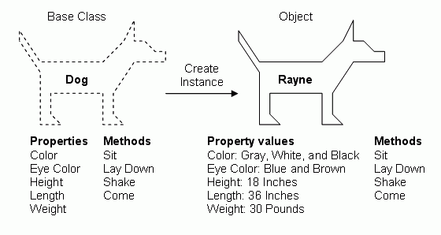
Class and Objects

Slide 29
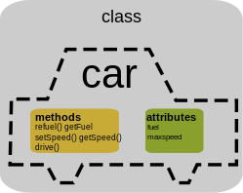
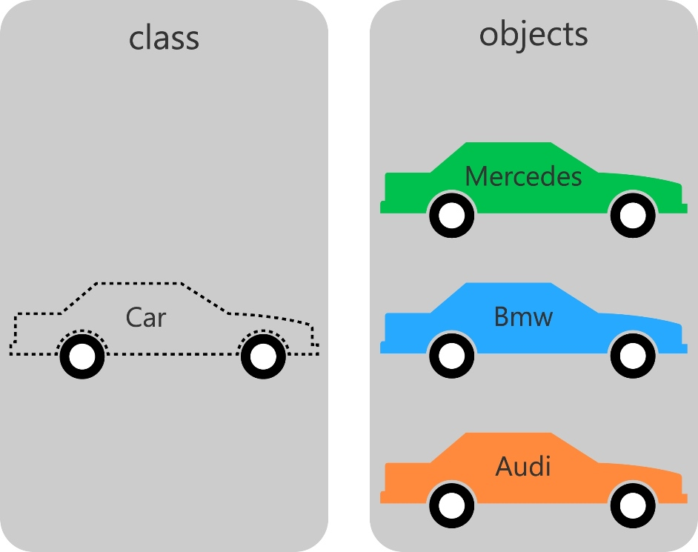
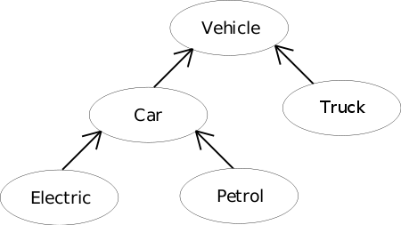
Class Hierarchies
As in most object-oriented languages, classes in C++ form hierarchies in which subclasses inherit the behavior and representation of their superclass.
Unlike many languages, C++ allows classes to inherit from more than one superclass, which is called multiple inheritance. This technique is easy to abuse and is therefore not discussed until later Chapters.

Slide 30

Biological Class Hierarchy
Living Things
Kingdom
Plants
Animals
Fungi
Phylum
Annelida
Brachiopoda
Arthropoda
Mollusca
Chordata
Class
Crustacea
Insecta
Arachnida
Order
Hymenoptera
Formicidae
Every black ant is also an animal, an arthropod, and an insect, as well as the other superclasses in the chain.
Family
Classification of the common black ant Lasius niger
Note that there can be many individual black ants, each of which is an instance of the same basic class.
Genus
Lasius
Species
niger
Notes:
域、界、门、纲、目、科、属、种
Domain, Kingdom, Phylum, Class, Order, Family, Genus, Species

Slide 31
Selected Classes in the Stream Hierarchy
ios
istream
ostream
iostream
ifstream
istringstream
ofstream
ostringstream

Slide 32
The Stream Hierarchy
Library vs. Class hierarchy: Interestingly, the C++ stream libraries are not organized based on the class hierarchies.

Slide 33
UML Diagram for the Stream Hierarchy
<fstream>
ios
<sstream>
clear()
fail()
eof()
istream
ostream
get()
unget()
>>
put()
<<
ifstream
istringstream
ofstream
ostringstream
open(cstr)
close()
istringstream(s)
open(cstr)
close()
str()
Question: Can we organize the hierarchy differently?

Slide 34
UML Diagram for an Alternative Hierarchy
ios
clear()
fail()
eof()
fstream
stringstream
open(cstr)
close()
ifstream
ofstream
istringstream
ostringstream
get()
unget()
>>
put()
<<
istringstream(s)
get()
unget()
>>
str()
put()
<<
Question: Is this hierarchy a better one?

Slide 35

Copy Contents between Streams
int main() {
ifstream infile;
promptUserForFile(infile, "Input file: ");
char ch;
while (infile.get(ch)) {
cout.put(ch);
}
infile.close();
return 0;
}
copyStream(infile, cout);
void copyStream(ifstream & infile, ofstream & outfile) {
char ch;
while (infile.get(ch)) {
outfile.put(ch);
}
}
void copyStream(istream & is, ostream & os) {
char ch;
while (is.get(ch)) {
os.put(ch);
}
}

Slide 36
The End

